Slide 1
MCI Project
P8: Analysing the content of README files on GitHub
Hangyue Xu & I-Sheng Chris Wang
22/3/2017

Slide 2
Outline
Introduction of GitHub
README files
What is this project
Importance of this project
Value of this project
Time limit
Conclusion

Slide 3
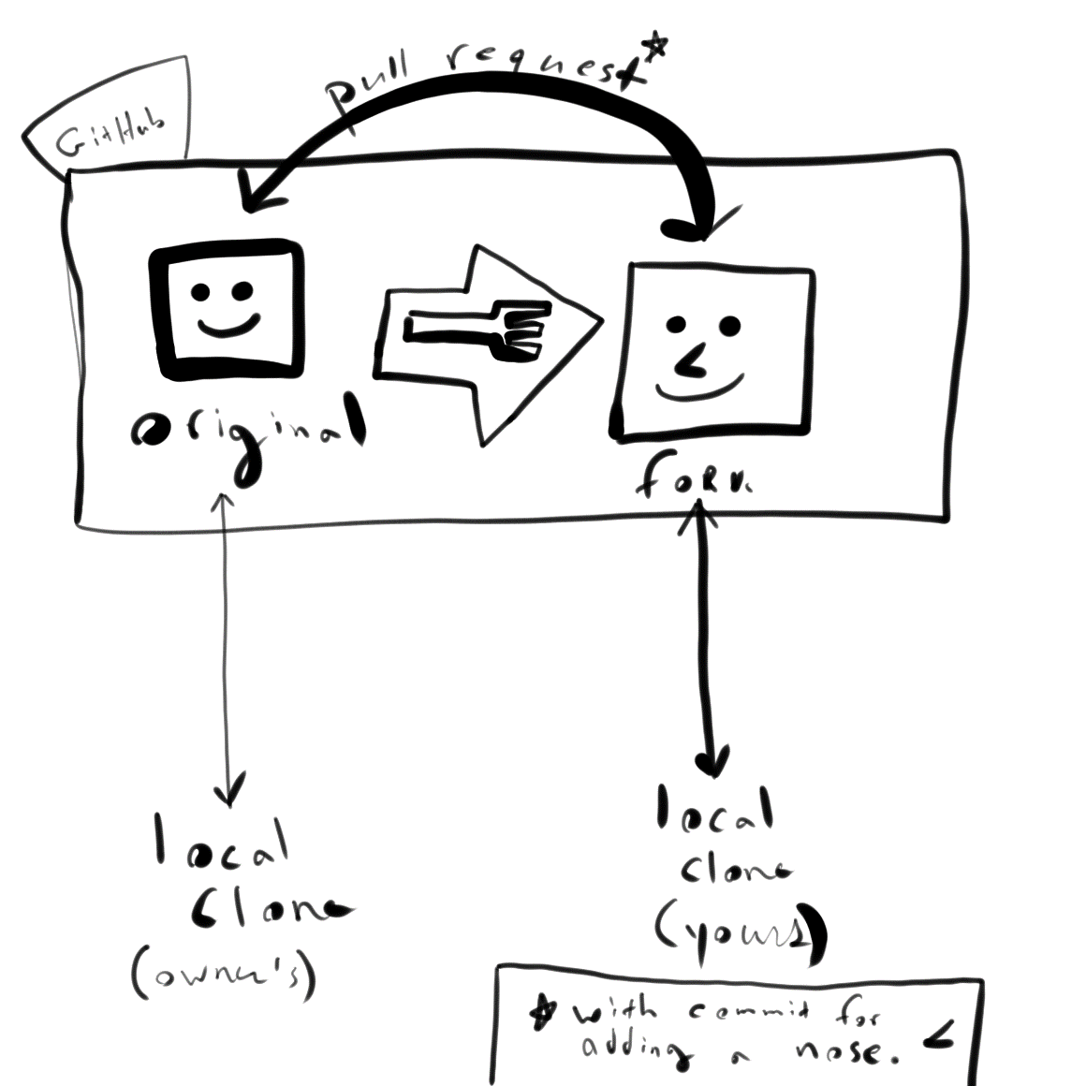
What is GitHub?
Code storage platform
Version control
Information sharing
A pull request of GitHub (Adafruit 2015)
The University of Adelaide- MCI Project 2017

Slide 4
README files
Contains information about other files in a directory or archive
Is used to generate GitHub’s html summary.
Language: markdown (md)
The University of Adelaide- MCI Project 2017

Slide 5
What is the project all about?
Systematically analyse the content of GitHub README files.
Use either Desktop application or Web application to randomly select a number of GitHub projects.
The University of Adelaide- MCI Project 2017

Slide 6
3. Extracts section titles
4. Extracts links from README files
5. Aggregate the information and present/download it in aggregated form.
The University of Adelaide- MCI Project 2017

Slide 7
Next presenter…
The University of Adelaide- MCI Project 2017

Slide 8

Normally the README files will have the following format:
Introduction
Requirements
Recommended modules
Installation guide
Configuration
Troubleshooting
FAQ
Maintainers
The University of Adelaide- MCI Project 2017

Slide 9

Another format of README file (possibly):
Synopsis
Code Example
Motivation
API reference
Tests
Contributors
License
The University of Adelaide- MCI Project 2017

Slide 10

Purpose of this project:
Create a summary (titles and sub titles, URLs, etc.)
The University of Adelaide- MCI Project 2017

Slide 11
Why the project is important?
Understand across many projects.
Produce a clear-cut overall content of the README file.
If possible, the highest data analysed based on the aggregated form of the information will become README file template on every GitHub project in the future.
The University of Adelaide- MCI Project 2017

Slide 12
Why it is worth to analyse the content of README files on GitHub?
The University of Adelaide- MCI Project 2017

Slide 13
of the READMEs don’t want the user to know the project’s name.
17%
31%
46%
of the READMEs don’t want the user to know where is the project is.
of the READMEs don’t want the user to know what the project is
Research studies done by Daniel D.Beck during his speech:
Youtube available: https://www.youtube.com/watch?v=2dAK42B7qtw
The University of Adelaide- MCI Project 2017

Slide 14
Our main features:
Randomly extract the project repositories
Extract the project title and sub-titles.
Extract the project URLs.
Aggregate the project title, sub-titles, URL.
Follow the same syntax for every repository.
The University of Adelaide- MCI Project 2017

Slide 15

Why it is worth it?
A guideline for the new users who intend to write the README file at their first time.
2. New users can gain some idea from the aggregated form of summary.
The University of Adelaide- MCI Project 2017

Slide 16
Why it is worth it?
3. Can be a useful tool for the researchers, especially for the statistical researchers.
4. The result will give insights into how software developers document their projects and how documentation can be improved.
The University of Adelaide- MCI Project 2017

Slide 17
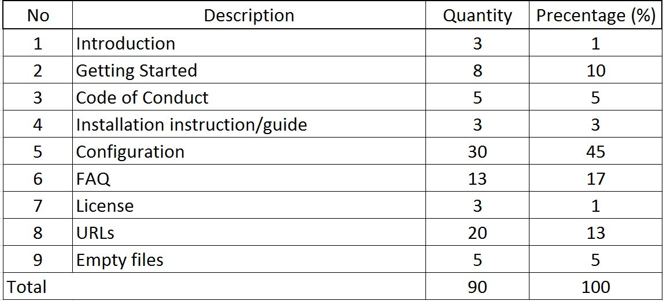
Summary of the project
Expected result:
Section titles
Links
No content in README file
The University of Adelaide- MCI Project 2017

Slide 18
If time allowed:….
More functions will be added:
Aggregate the words in README files
Aggregate the characters in README files
Aggregate the images/pictures in README files
The University of Adelaide- MCI Project 2017

Slide 19

Can it be done in one semester?
Depends the person’s ability.
Everyone has different background and knowledge acquired. However, for us, we will try to develop our stated requirements within a semester.
The University of Adelaide- MCI Project 2017

Slide 20
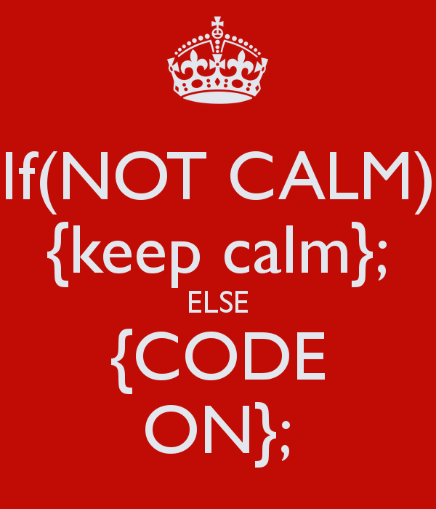
Thank you
The University of Adelaide- MCI Project 2017

